Slide 1
Minimum Requirements
21 years of age at time of hire
United States Citizen
Valid driver’s license
Valid CHIP card at 50% level
Wages
New Officers:
Starting: $56,243.20
6 months: $58,926.40
1.5 years: $81,556.80 2.5 years: $87,505.60 3.5 years: $91,520.00
Certified Officers:
Starting: $78,020.80 2.5 years: $87,505.60 3.5 years: $91,520.00
Education Incentive:
After 3 ½ years of service if you have a degree, we’ll pay you:
Associates degree= $6 per week
Bachelor’s degree= $25 per week
Masters degree= $35 per week
Benefits
Paid Holidays or additional days off:
11 holidays for which you can receive Holiday pay; or receive a day off to use another day.
Personal Days:
2 Personal days per calendar year.
Vacation time:
01-05 years service = 2 weeks vacation
05-10 years service = 3 weeks vacation
10-20 years service = 4 weeks vacation
20 or more years = 5 weeks vacation
Sick Time:
15 sick days per year
124 person Department with special assignments and availability for growth!
Compensatory Time:
If you don’t want overtime pay, you can hold on to up to 8 days off in lieu of pay.
Earned Days:
Don’t call out sick for 6 months, we’ll give you a day off!
Insurances:
Health: Health Savings Account Plan
Dental: CIGNA Dental PPO – Radius
Life Insurance: 1 times annual salary
Vision / Hearing Expenses
Tuition reimbursement:
$1,400/year for undergraduate courses $2,000/year for graduate courses
Retirement: 50% base pay pension after 25 years service, PLUS city match 3% 401 plan
Selection Process
For more information please visit: https://www.policeapp.com
Meriden is a small city where Police Officers are challenged to be real cops but also work with the community and neighborhood groups to find modern solutions to modern day problems to make Meriden safer for people to live and raise a family.
Career Opportunities
Work Schedule
Patrol Officers work 4 eight hour days, followed by 2 days off. That’s 17 fewer days per year than a Monday through Friday schedule!
Shifts include:
Midnights (11PM-7AM) 6% Premium Pay
Days (7AM-3PM)
Evenings (3PM-11PM) 7% Premium Pay
Shift availability is based on seniority.
Special assignments/Detective Division work a Monday-Friday schedule
Honor Guard
School Resource Officer
S.W.A.T.
Bicycle Patrol Officer
Field Training Officer
Accident Reconstruction
Canine handler
DEA Task Force
Statewide Narcotics
Postal Task Force
Crime Suppression Unit
Neighborhood Initiative Unit (Community Policing Division)
Drone Operations
Full Detective Bureau including: Major Crimes, Sex Crimes/Youth Division, Fraud, Narcotics, Human Trafficking, Evidence/Identification

Slide 2
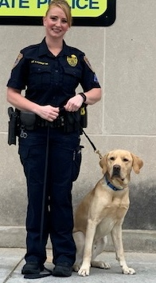
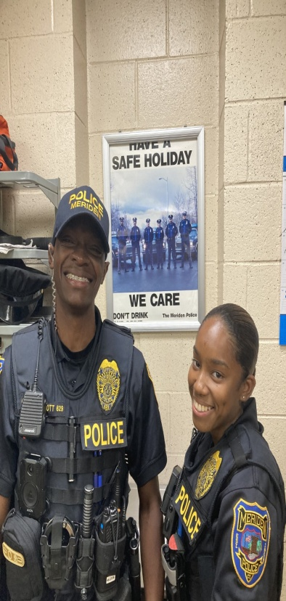
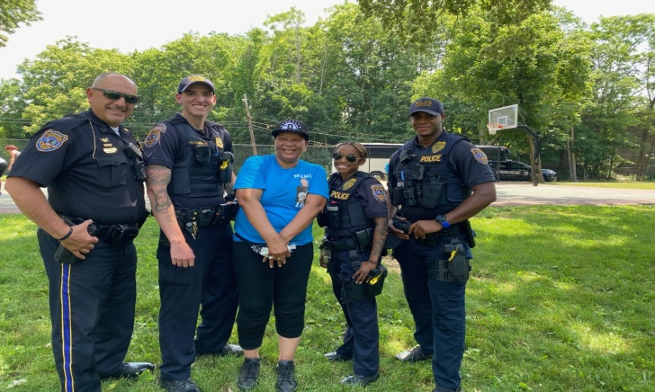
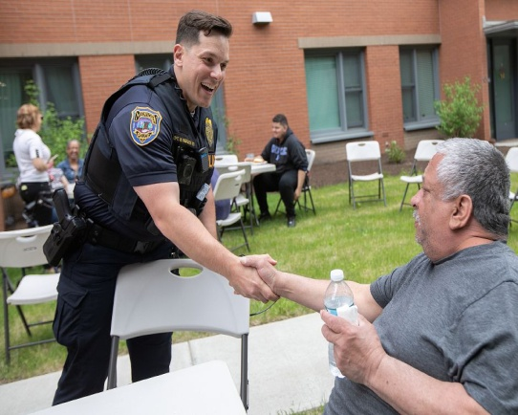
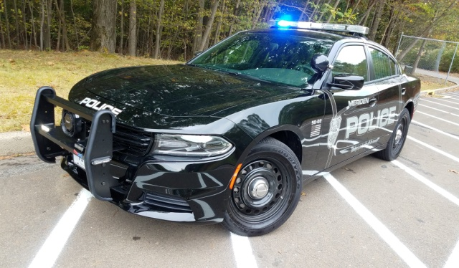
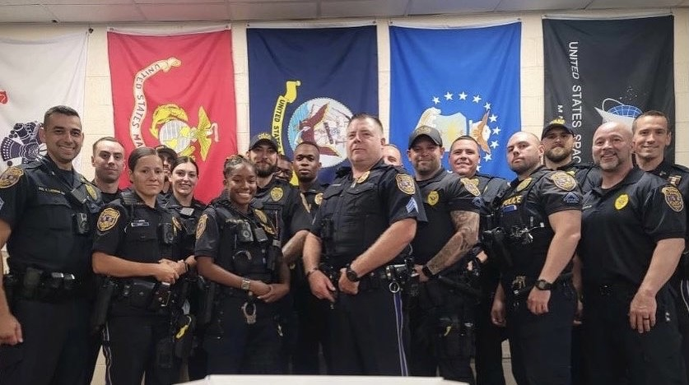
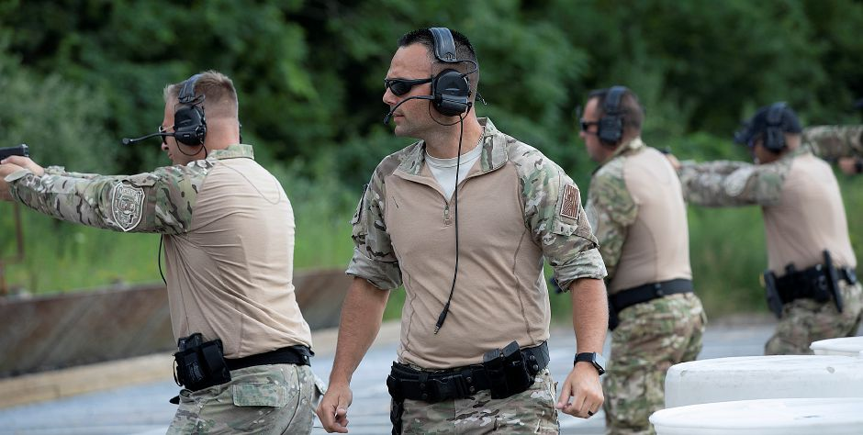
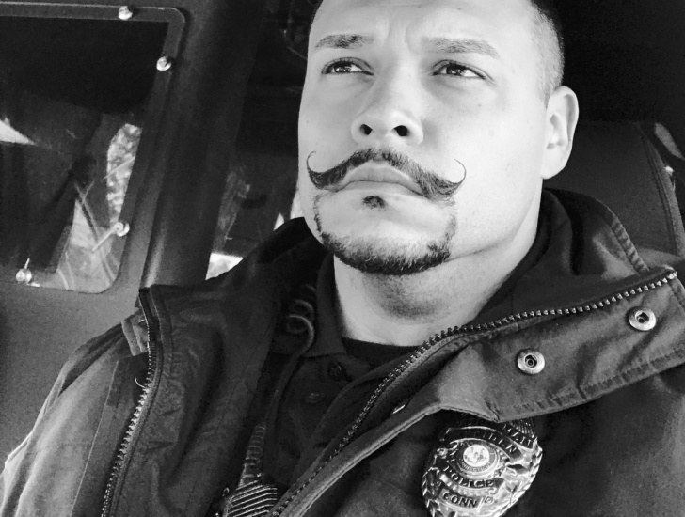
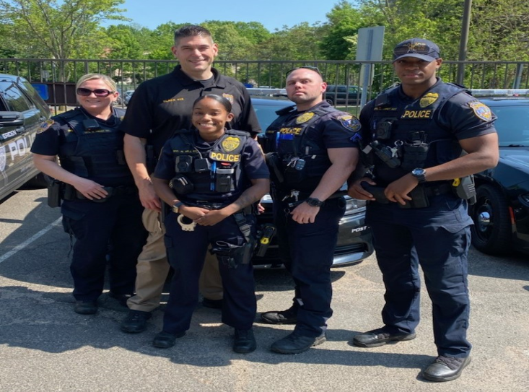
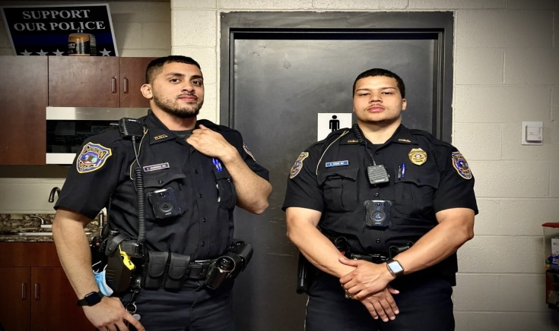
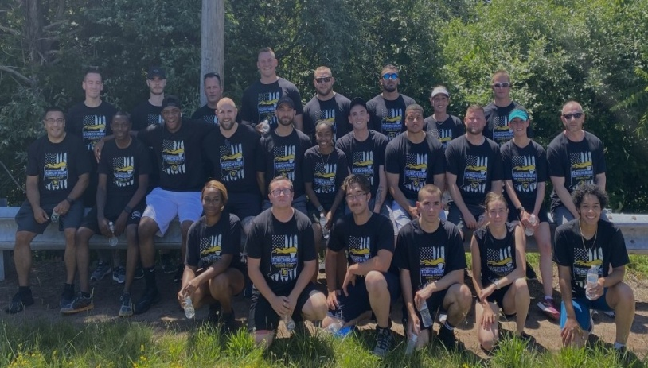
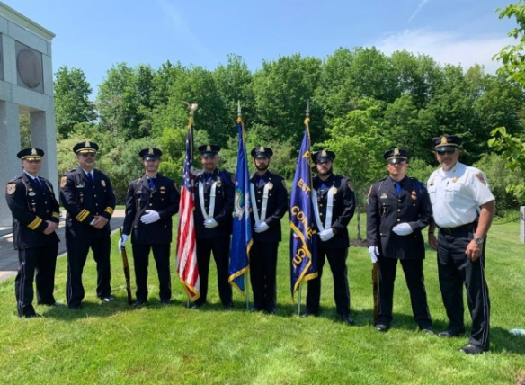
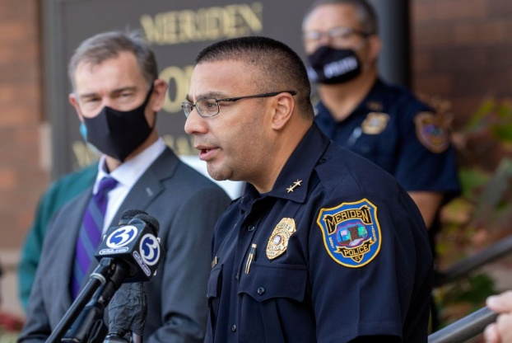
Do you have strong morals and work ethic, non biased decision making skills, strong communication and teamwork?
If you answered YES, we’re looking for you to join our family of professional Police Officers to make Meriden a safer place.
Are you willing to take the MPD challenge ?
Check out our Insta @ meridenpdct
or Facebook @
Meriden Police Department
City of Meriden Police Department
:
“Working in partnership with the community”
Integrity
Compassion
Fairness
The City of Meriden is an equal opportunity employer, encouraging women and minorities to apply.

